Slide 1

MotorAuctionX
CS527: DBDS
Aayush Patel (ap3084) Li Hua Peng (lp880) Shantanu Agrawal (sa2792) Sritama Ghosh (sg2450)

Slide 2





Tech Stack:

Slide 3
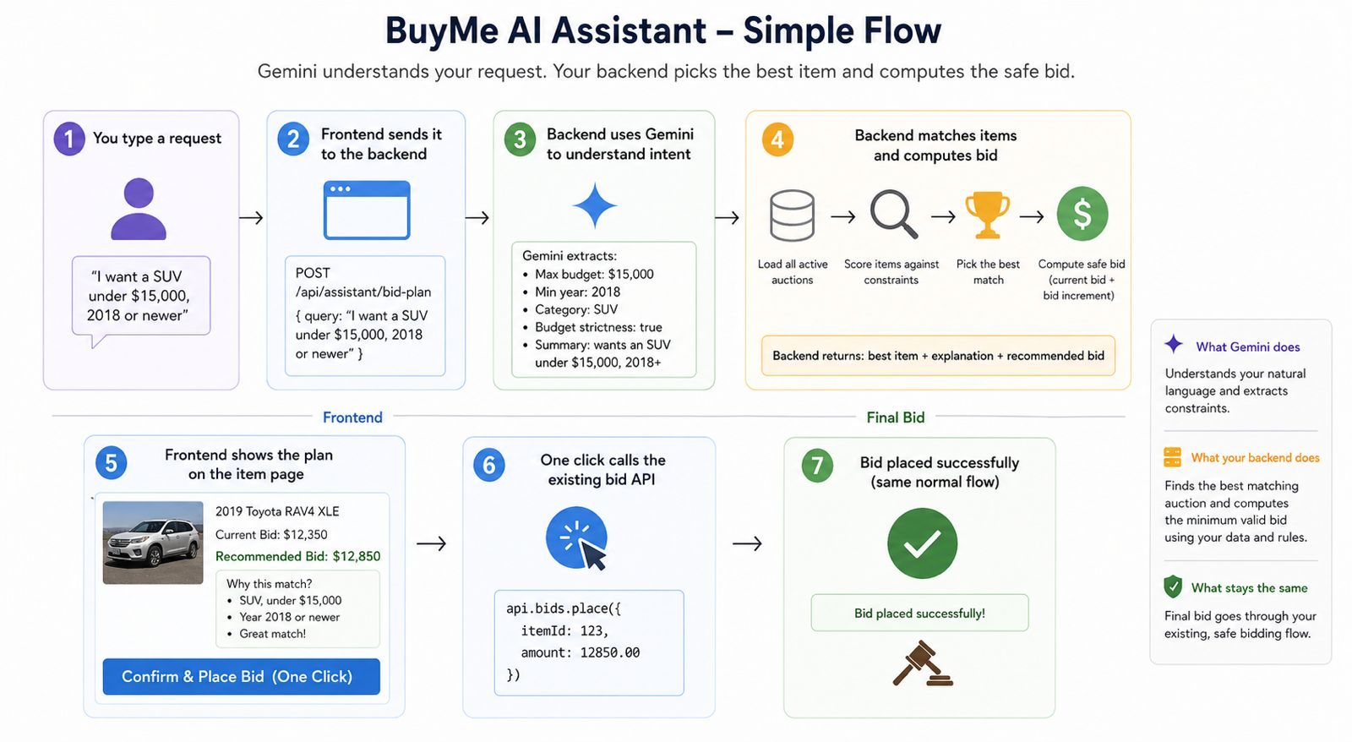

Slide 4
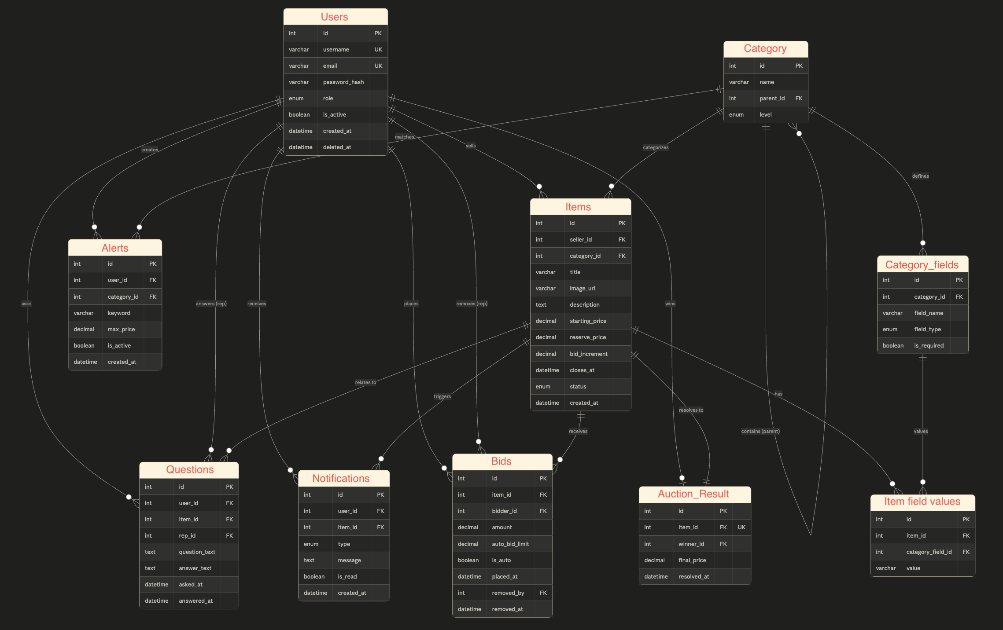

Slide 5
